Slide 1
Amazon Elastic Kubernetes Service Amazon EKS
Thang Tran
Mar 31, 2021

Slide 2
Agenda
Pre-requisites
Amazon ESK introduction
Kubernetes Package Manager: Helm
EKS Cluster Autoscaler
Demo

Slide 3
Pre-requisites
Docker and Container
Kubernetes Basics
YAML template

Slide 4
Amazon EKS Introduction
Certified Kubernetes conformity by CNCF (Cloud Native Computing Foundation).
Compatible with existing plug ins and tooling of Kubernetes in any way.
Easily migrate any standard Kubernetes application to EKS without any changes to your code.

Slide 5
Certified Kubernetes by CNCF
Source: Cloud Native Computing Foundation

Slide 6
Amazon EKS Introduction
Certified Kubernetes conformity by CNCF (Cloud Native Computing Foundation).
Compatible with existing plug ins and tooling of Kubernetes in any way.
Easily migrate any standard Kubernetes application to EKS without any changes to your code.
EKS runs the Kubernetes control plane across multiple AWS Availability Zones.

Slide 7
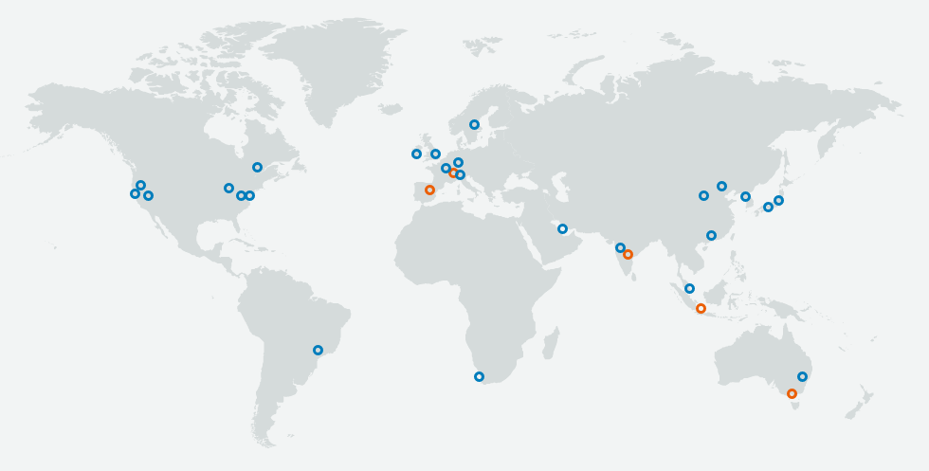
AWS Availability Zones – 25 Regions and 80 AZs

Slide 8
Amazon EKS Introduction
Certified Kubernetes conformity by CNCF (Cloud Native Computing Foundation).
Compatible with existing plug ins and tooling of Kubernetes in any way.
Easily migrate any standard Kubernetes application to EKS without any changes to your code.
EKS runs the Kubernetes control plane across multiple AWS Availability Zones.
Integrate with others AWS services: Elastic Load Balancing, Auto Scaling Group, VPC, CloudTrail, CloudWatch and IAM.

Slide 9
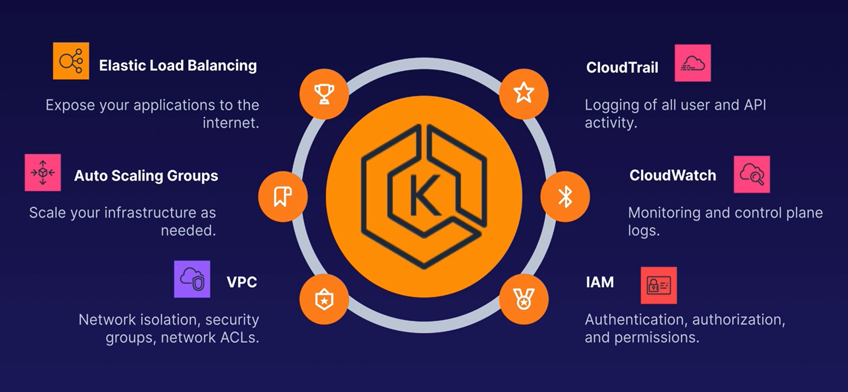
Integrate with others AWS services

Slide 10
Amazon EKS Introduction
Certified Kubernetes conformity by CNCF (Cloud Native Computing Foundation).
Compatible with existing plug ins and tooling of Kubernetes in any way.
Easily migrate any standard Kubernetes application to EKS without any changes to your code.
EKS runs the Kubernetes control plane across multiple AWS Availability Zones.
Integrate with others AWS services: Elastic Load Balancing, Auto Scaling Group, VPC, CloudTrail, CloudWatch and IAM.
Latest security patches automatically applied.
Get Up and Running in a single command.

Slide 11
Amazon EKS Introduction (continue)
EKS offers a 99.95% uptime SLA.
EKS console provides observability of your Kubernetes clusters so you can identify and resolve issues faster.

Slide 12
Kubernetes Package Manager: Helm
Helm is a chart manager.
Charts are packages of pre-configured Kubernetes resources.
Release is a collection of Kubernetes resources deployed to the cluster using Helm.

Slide 13
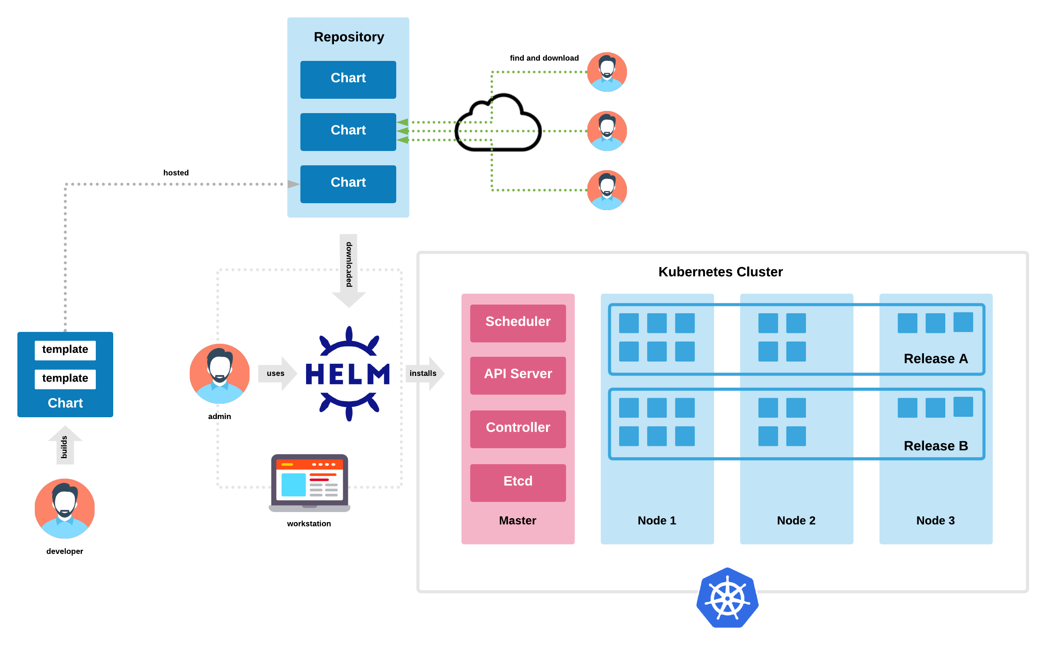
Helm & Helm Chart

Slide 14
Amazon EKS Cluster Autoscaler
Helm is a tool that streamlines installing and managing Kubernetes applications, a packages manager.
Charts are Helm packages of pre-configured Kubernetes resources.
Release is a collection of Kubernetes resources deployed to the cluster using Helm.

Slide 15
Auto Scaling

Slide 16
Q&A
Where do I store Docker image used in EKS?
Amazon Elastic Container Registry (ECR).
Compare EKS to others Cloud Provider’s Container Services
60% Kubernetes orchestration was deployed to EKS.
How do I monitor cluster health?
There’s a lot of tools in the market: Grafana, Datadog, Dynatrace etc.

Slide 17
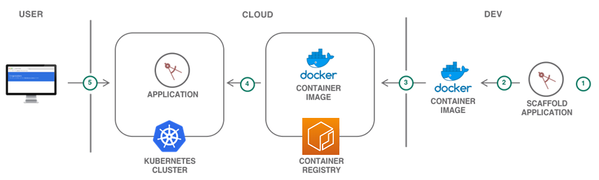
Amazon Elastic Container Registry (ECR)

Slide 18
AWS EKS vs Others Cloud Provider’s Container Services

Slide 19
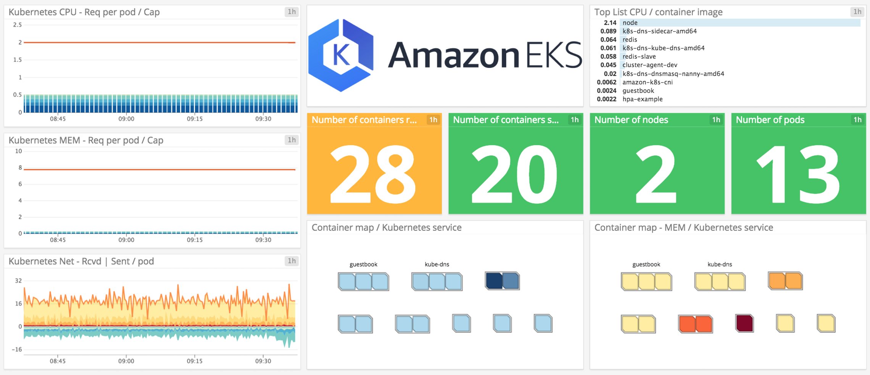
Datadog

Slide 20
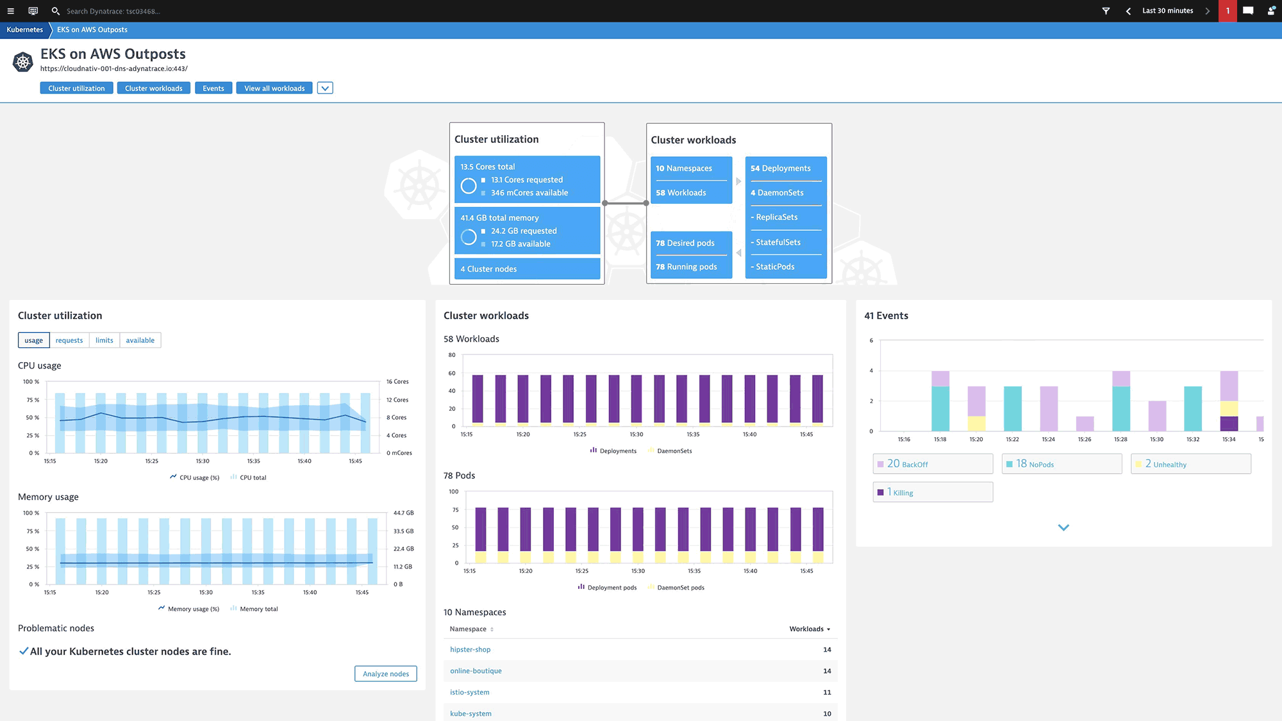
Dynatrace

Slide 21
Demo

Slide 22
References
12 Docker Container Monitoring Tools You Should Be Using.
Draft vs Gitkube vs Helm vs Ksonnet vs Metaparticle vs Skaffold
Terraform, helm, and kops as a cloud infrastructure package
Managing Kubernetes storage classes

